Slide 1
CS2100 Tutorial 3
MIPS
Slides by Theodore, adapted from Prof. Aaron’s slides

Slide 2
Overview
Q1) C to MIPS translation
Q2) MIPS instruction encoding
Q3) Completing MIPS code
Q4) MIPS Tracing
Bonus (look on your own): Next steps for C

Slide 3
Admin stuff
Discussion question:
do on your own, discuss in Canvas, ask me if anything
MIPS Sheet
take one (in-front) if you haven't last week
would be useful until exam time

Slide 4

Promotion: "Debugging with GDB" talk
RSVP:
NUS: https://nus.campuslabs.com/engage/event/10352925
Non-NUS: https://docs.google.com/forms/d/e/1FAIpQLScJpX-bDTsPgGmmCrmmpR6HCTdLU7UbOCno523ZJkSPUFd4VQ/viewform
Ever wondered how to incorporate debugging with GDB into your C programming workflow? Had a hard time learning to use GDB to debug your application? In this workshop, we will be learning to use GDB to effectively debug our application.
Requirements: If you’re using macOS or Linux, you’re all set! Windows users: You can install Windows Subsystem for Linux (WSL) or run Ubuntu in VirtualBox.
Speaker Profile: NUS Greyhats are an information security interest group based in the National University of Singapore. They play CTFs and organize weekly meetups they call Security Wednesdays!

Slide 5
Prelude to Q1: C’s “short-circuit eval”
(If you took CS1101S, this should be familiar to you!)
Q: What’s the result of evaluating the following in C:
int main() {
if (1 > 2 && 5/0 > 3) {
print(“aye”);
} else {
print(“nay”);
}
}
Compile Error
Segmentation fault
“aye”
“nay”
None of the above

Slide 6
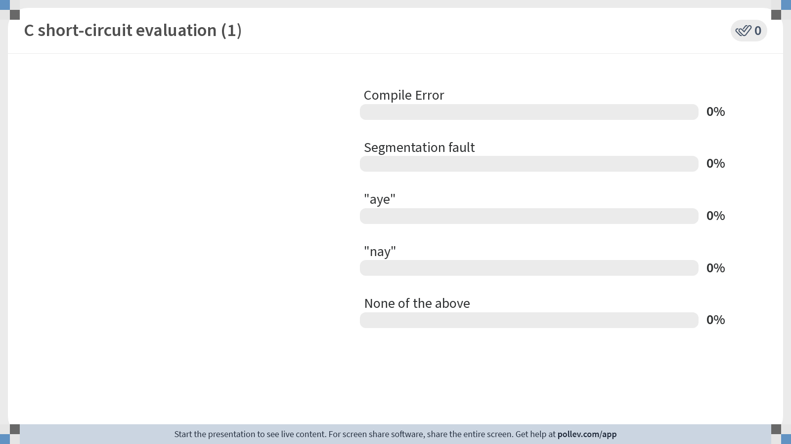
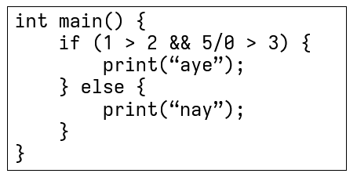
Notes:
Poll Title: Do not modify the notes in this section to avoid tampering with the Poll Everywhere activity. More info at polleverywhere.com/support C short-circuit evaluation (1) https://www.polleverywhere.com/multiple_choice_polls/0s6A089u7AY5yM8iFhDaW?state=opened&flow=Default&onscreen=persist

Slide 7
Prelude to Q1: C’s “short-circuit eval”
(If you took CS1101S, this should be familiar to you!)
Q: If we switched the order of the operands…?
int main() {
if (5/0 > 3 && 1 > 2) {
print(“aye”);
} else {
print(“nay”);
}
}
Compile Error
Segmentation fault
“aye”
“nay”
None of the above

Slide 8
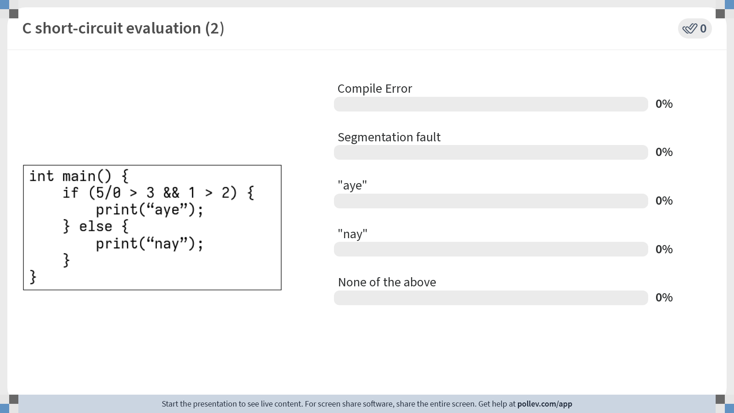
Notes:
Poll Title: Do not modify the notes in this section to avoid tampering with the Poll Everywhere activity. More info at polleverywhere.com/support C short-circuit evaluation (2) https://www.polleverywhere.com/multiple_choice_polls/sxNuYpEsRTharXPKFuvpF?state=opened&flow=Default&onscreen=persist

Slide 9
Q1: C to MIPS
char str[size] = { ... }; // some string
int lo, hi, matched; // matched = 1 (palindrome);
// matched = 0 (not palindrome)
// Translate to MIPS from this point onwards
lo = 0;
hi = size-1;
matched = 1; // assume this is a palindrome
while ((lo < hi) && matched) {
if (str[lo] != str[hi])
matched = 0; // found a mismatch
else {
lo++;
hi--;
}}
Variable mappings:
lo → $s0;
hi → $s1;
matched → $s3;
Base address of str[] → $s4;
size → $s5

Slide 10
Q1. C → MIPS
 | addi $s0, $zero, 0 | # lo = 0
 | addi $s1, $s5, -1 | # hi = size – 1
 | addi $s3, $zero, 1 | # matched = 1
loop: | slt $t0, $s0, $s1 | # (lo < hi)?
 | beq $t0, $zero, exit | # exit if (lo >= hi)
 | beq $s3, $zero, exit | # exit if (match == 0)
 | add $t1, $s4, $s0 | # addr of str[lo]
 | lb $t2, 0($t1) | # $t2 = str[lo]
 | add $t3, $s4, $s1 | # addr of str[hi]
 | lb $t4, 0($t3) | # $t4 = str[hi]
 | beq $t2, $t4, else | # compare str[lo], str[hi]
 | addi $s3, $zero, 0 | # matched = 0
 | j loop | # can also be “j endW”
else: | addi $s0, $s0, 1 | # lo++
 | addi $s1, $s1, -1 | # hi--
endW: | j loop
exit:
lo = 0; hi = size-1; matched = 1;
while ((lo < hi) && matched) {
if (str[lo] != str[hi]) matched = 0;
else { lo++; hi--;
}
}
Variable mappings: lo → $s0; hi → $s1; matched → $s3;
Base address of str[] → $s4; size → $s5

Slide 11
Q1. C → MIPS
 | addi $s0, $zero, 0 | # lo = 0
 | addi $s1, $s5, -1 | # hi = size – 1
 | addi $s3, $zero, 1 | # matched = 1
loop: | slt $t0, $s0, $s1 | # (lo < hi)?
 | beq $t0, $zero, exit | # exit if (lo >= hi)
 | beq $s3, $zero, exit | # exit if (match == 0)
 | add $t1, $s4, $s0 | # addr of str[lo]
 | lb $t2, 0($t1) | # $t2 = str[lo]
 | add $t3, $s4, $s1 | # addr of str[hi]
 | lb $t4, 0($t3) | # $t4 = str[hi]
 | beq $t2, $t4, else | # compare str[lo], str[hi]
 | addi $s3, $zero, 0 | # matched = 0
 | j loop | # can also be “j endW”
else: | addi $s0, $s0, 1 | # lo++
 | addi $s1, $s1, -1 | # hi--
endW: | j loop
exit:
lo = 0; hi = size-1; matched = 1;
while ((lo < hi) && matched) {
if (str[lo] != str[hi]) matched = 0;
else { lo++; hi--; }
}
Variable mappings: lo → $s0; hi → $s1; matched → $s3;
Base address of str[] → $s4; size → $s5

Slide 12
Q1. C → MIPS
 | addi $s0, $zero, 0 | # lo = 0
 | addi $s1, $s5, -1 | # hi = size – 1
 | addi $s3, $zero, 1 | # matched = 1
loop: | slt $t0, $s0, $s1 | # (lo < hi)?
 | beq $t0, $zero, exit | # exit if (lo >= hi)
 | beq $s3, $zero, exit | # exit if (match == 0)
 | add $t1, $s4, $s0 | # addr of str[lo]
 | lb $t2, 0($t1) | # $t2 = str[lo]
 | add $t3, $s4, $s1 | # addr of str[hi]
 | lb $t4, 0($t3) | # $t4 = str[hi]
 | beq $t2, $t4, else | # compare str[lo], str[hi]
 | addi $s3, $zero, 0 | # matched = 0
 | j loop | # can also be “j endW”
else: | addi $s0, $s0, 1 | # lo++
 | addi $s1, $s1, -1 | # hi--
endW: | j loop
exit:
Note 1: blt pseudo-instruction
lo = 0; hi = size-1; matched = 1;
while ((lo < hi) && matched) {
if (str[lo] != str[hi]) matched = 0;
else { lo++; hi--;
}
}
Variable mappings: lo → $s0; hi → $s1; matched → $s3;
Base address of str[] → $s4; size → $s5

Slide 13
Q1. C → MIPS
 | addi $s0, $zero, 0 | # lo = 0
 | addi $s1, $s5, -1 | # hi = size – 1
 | addi $s3, $zero, 1 | # matched = 1
loop: | slt $t0, $s0, $s1 | # (lo < hi)?
 | beq $t0, $zero, exit | # exit if (lo >= hi)
 | beq $s3, $zero, exit | # exit if (match == 0)
 | add $t1, $s4, $s0 | # addr of str[lo]
 | lb $t2, 0($t1) | # $t2 = str[lo]
 | add $t3, $s4, $s1 | # addr of str[hi]
 | lb $t4, 0($t3) | # $t4 = str[hi]
 | beq $t2, $t4, else | # compare str[lo], str[hi]
 | addi $s3, $zero, 0 | # matched = 0
 | j loop | # can also be “j endW”
else: | addi $s0, $s0, 1 | # lo++
 | addi $s1, $s1, -1 | # hi--
endW: | j loop
exit:
Note 2: how to load
lo = 0; hi = size-1; matched = 1;
while ((lo < hi) && matched) {
if (str[lo] != str[hi]) matched = 0;
else { lo++; hi--;
}
}
Variable mappings: lo → $s0; hi → $s1; matched → $s3;
Base address of str[] → $s4; size → $s5

Slide 14
Q1. C → MIPS
 | addi $s0, $zero, 0 | # lo = 0
 | addi $s1, $s5, -1 | # hi = size – 1
 | addi $s3, $zero, 1 | # matched = 1
loop: | slt $t0, $s0, $s1 | # (lo < hi)?
 | beq $t0, $zero, exit | # exit if (lo >= hi)
 | beq $s3, $zero, exit | # exit if (match == 0)
 | add $t1, $s4, $s0 | # addr of str[lo]
 | lb $t2, 0($t1) | # $t2 = str[lo]
 | add $t3, $s4, $s1 | # addr of str[hi]
 | lb $t4, 0($t3) | # $t4 = str[hi]
 | beq $t2, $t4, else | # compare str[lo], str[hi]
 | addi $s3, $zero, 0 | # matched = 0
 | j loop | # can also be “j endW”
else: | addi $s0, $s0, 1 | # lo++
 | addi $s1, $s1, -1 | # hi--
endW: | j loop
exit:
Note 3: lb vs lw
lo = 0; hi = size-1; matched = 1;
while ((lo < hi) && matched) {
if (str[lo] != str[hi]) matched = 0;
else { lo++; hi--;
}
}
Variable mappings: lo → $s0; hi → $s1; matched → $s3;
Base address of str[] → $s4; size → $s5

Slide 15
Q1b.
add $t1, $s4, $s0 # addr. of str[lo]
add $t3, $s4, $s1 # addr. of str[hi]
slt $t0, $t1, $t3 # compare lo and hi addr
 | addi $s0, $zero, 0
 | addi $s1, $s5, -1
 | addi $s3, $zero, 1
loop: | slt $t0, $s0, $s1 | # (lo < hi)?
 | beq $t0, $zero, exit | # exit if (lo >= hi)
 | beq $s3, $zero, exit | # exit if (match == 0)
 | add $t1, $s4, $s0 | # addr of str[lo]
 | lb $t2, 0($t1) | # $t2 = str[lo]
 | add $t3, $s4, $s1 | # addr of str[hi]
 | lb $t4, 0($t3) | # $t4 = str[hi]
 | beq $t2, $t4, else | # compare str[lo], str[hi]
 | addi $s3, $zero, 0 | # matched = 0
 | j loop | # can also be “j endW”
else: | addi $s0, $s0, 1 | # lo++
 | addi $s1, $s1, -1 | # hi--
endW: | j loop
exit:
addi $t1, $t1, 1 # lo addr increment
addi $t3, $t3, -1 # hi addr decrement
Variable mappings: lo → $s0; hi → $s1; matched → $s3;
Base address of str[] → $s4; size → $s5

Slide 16
Prelude to Q2: MIPS Instruction Encoding
Remember and distinguish between R/I/J instructions!
R-format instructions: operations using 3 registers OR shifts
Example: add, and, slt, sll
I-format instructions: operations using 2 register and an imm value
Example: addi, beq, lw, sw
J-format instruction: jump instructions
Example: j, jal
Other formats not in syllabus
See reference data: there's FI/FR-formats for floats
Assessments can have custom instruction formats!

Slide 17

Prelude to Q2: MIPS Instruction Encoding
Be careful about the ordering!
Instruction:
add $t0, $t1, $t2
(opcode 0, funct 20₁₆) rd (dest) rs (source) rt (target)
MIPS Reference Sheet:

Slide 18
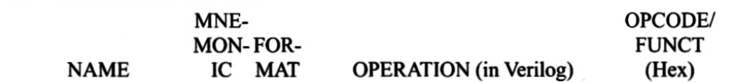
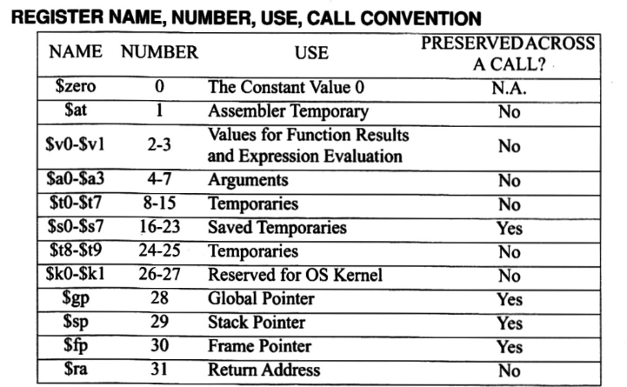
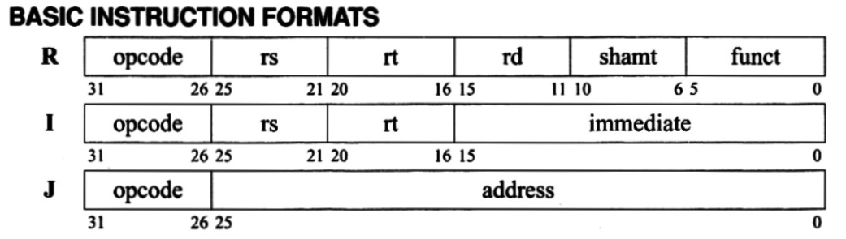
Q2: MIPS Instruction Encoding
addi $s1, $zero, 0

Slide 19
Q2: MIPS Instruction Encoding
addi $s1, $zero, 0
rt rs SignExtImm
rt = $s1 = $(16+1) = $17
rs = $zero = $0

Slide 20
Q2: MIPS Instruction Encoding
addi $s1, $zero, 0
rt rs SignExtImm
rt = $s1 = $(16+1) = $17
rs = $zero = $0

Slide 21
Q2: MIPS Instruction Encoding
addi $s1, $zero, 0
rt rs SignExtImm
rt = $s1 = $(16+1) = $17
rs = $zero = $0
Ans:(2011 0000)₁₆

Slide 22
Q2: MIPS Instruction Encoding
0x11000002
=0b 0001 0001 0000 0000 0000 00000 0000 0010
First, check the opcode (first 6 bits), which is 000100₂ = 4₁₆

Slide 23
Q2: MIPS Instruction Encoding
0x11000002
=0b 0001 0001 0000 0000 0000 00000 0000 0010
Second, check the Reference Sheet for opcode 4₁₆.
Now we know it's a beq instruction with I-format.

Slide 24
Q2: MIPS Instruction Encoding
0x11000002
=0b 0001 0001 0000 0000 0000 00000 0000 0010

Slide 25
Q2: MIPS Instruction Encoding
0x11000002
=0b 0001 0001 0000 0000 0000 00000 0000 0010
opcode 000100 = 4
rs 01000 = 8
rt 00000 = 0
immediate 0100 = 2

Slide 26
Q2: MIPS Instruction Encoding
0x11000002
=0b 0001 0001 0000 0000 0000 00000 0000 0010
opcode 000100 = 4
rs 01000 = 8
rt 00000 = 0
immediate 0100 = 2
$8 is $t0; $0 is $zero, and the immediate value is +2.

Slide 27
Q2: MIPS Instruction Encoding
0x11000002
=0b 0001 0001 0000 0000 0000 00000 0000 0010
opcode --> beq
rs --> $t0
rt --> $zero
immediate --> +2

Slide 28
Q2: MIPS Instruction Encoding
0x11000002
=0b 0001 0001 0000 0000 0000 00000 0000 0010
opcode --> beq
rs --> $t0
rt --> $zero
immediate --> +2
Ans: beq $t0, $zero, exit
 | MIPS code
 | addi $s1, $zero, 0
0x00084042 | Loop: srl $t0, $t0, 1
0x11000002
0x22310001
 | j loop
 | exit:
Next instr.
+2 instr.

Slide 29
Q2: MIPS Instruction Encoding
0x22310001
=0b 0010 0010 0011 0001 0000 0000 0000 0001
opcode 010000₂ = 8₁₆
This means addi instruction, I-format

Slide 30
Q2: MIPS Instruction Encoding
0x22310001
=0b 0010 0010 0011 0001 0000 0000 0000 0001
opcode 010000₂ = 8₁₆
This means addi instruction, I-format
0b 0010 0010 0011 0001 0000 0000 0000 0001
opcode rs rt imm (SignExtImm)

Slide 31
Q2: MIPS Instruction Encoding
0x22310001
=0b 0010 0010 0011 0001 0000 0000 0000 0001
opcode 010000₂ = 8₁₆
This means addi instruction, I-format
0b 0010 0010 0011 0001 0000 0000 0000 0001
opcode rs rt imm (SignExtImm)
8₁₆ 17₁₀ 17₁₀ 1₁₀
$s1 $s1

Slide 32
Q2: MIPS Instruction Encoding
0x22310001
=0b 0010 0010 0011 0001 0000 0000 0000 0001
opcode 010000₂ = 8₁₆
This means addi instruction, I-format
0b 0010 0010 0011 0001 0000 0000 0000 0001
opcode rs rt imm (SignExtImm)
8₁₆ 17₁₀ 17₁₀ 1₁₀
$s1 $s1
Answer: addi $s1, $s1, 1
inst rt rs imm

Slide 33
Q2: MIPS Instruction Encoding
j loop
We first try to find the address of where we want to jump
0x00400028 + 4
= 0x0040002C
MIPS code | Address
addi $s1, $zero, 0 | 0x00400028
Loop: srl $t0, $t0, 1 | ?
j loop
exit:

Slide 34
Q2: MIPS Instruction Encoding
j loop
We first try to find the address of where we want to jump
= 0x0040002C
= 0000 0000 0100 0000 0000 0000 0010 1100
As everything is word-aligned, we remove the last 2 bits;
To make it fit, we need to also throw away the first 4 bits.

Slide 35
Q2: MIPS Instruction Encoding
j loop
We first try to find the address of where we want to jump
= 0x0040002C
= 0000 0000 0100 0000 0000 0000 0010 1100
As everything is word-aligned, we remove the last 2 bits;
To make it fit, we need to also throw away the first 4 bits.
Answer: 000010 000001000000000000000010
0000 1000 0001 0000 0000 0000 0000 1011
0 8 1 0 0 0 0 B

Slide 36

Q2: MIPS Instruction Encoding
b) Give a simple mathematic expression for the relationship between $s1 and $t0
addi $s1, $zero, 0
loop: srl $t0, $t0, 1
beq $t0, $zero, exit
addi $s1, $s1, 1
j loop
exit:
$$\$s1=\left\lfloor \log_{2}(\$t0)\right\rfloor$$

Slide 37
Break
Take attendance :)

Slide 38
Q3(a)
MIPS code | Comment
loop: slt $t9, $s3, $s2 bne $t9, $zero, end | # while (lo <= hi) {
add $s4, $s2, $s3 [ ] | # mid = (lo + hi)/2
sll $t0, $s4, 2 add $t0, $s0, $t0 [ ] | # t0 = mid*4 # t0 = &array[mid] in bytes # t1 = array[mid]
slt $t9, $s1, $t1 beq $t9, $zero, bigger | # if (target < array[mid])
addi $s3, $s4, -1 j lpEnd | # hi = mid – 1
bigger:[ ] [ ] | # else if (target > array[mid])
addi $s2, $s4, 1 j lpEnd; | # lo = mid + 1
equal: add $s5, $s4, $zero [ ] | # else { ans = mid; break; }
lpEnd: [ ] | #} // end of while loop
end:
Binary search
Variable
mappings:
addr. of
array[0] → $s0;
target → $s1;
lo → $s2;
hi → $s3;
mid → $s4;
ans → $s5.

Slide 39
Q3(a)
MIPS code | Comment
loop: slt $t9, $s3, $s2 bne $t9, $zero, end | # while (lo <= hi) {
add $s4, $s2, $s3 [ ] | # mid = (lo + hi)/2
sll $t0, $s4, 2 add $t0, $s0, $t0 [ ] | # t0 = mid*4 # t0 = &array[mid] in bytes # t1 = array[mid]
slt $t9, $s1, $t1 beq $t9, $zero, bigger | # if (target < array[mid])
addi $s3, $s4, -1 j lpEnd | # hi = mid – 1
bigger:[ ] [ ] | # else if (target > array[mid])
addi $s2, $s4, 1 j lpEnd; | # lo = mid + 1
equal: add $s5, $s4, $zero [ ] | # else { ans = mid; break; }
lpEnd: [ ] | #} // end of while loop
end:
Binary search
srl $s4, $s4, 1
Variable
mappings:
addr. of
array[0] → $s0;
target → $s1;
lo → $s2;
hi → $s3;
mid → $s4;
ans → $s5.
lw $t1, 0($t0)
slt $t9, $t1, $s1
beq $t9, $zero, equal
j end
j loop

Slide 40
Q3.
MIPS code | Address
loop: slt $t9, $s3, $s2 bne $t9, $zero, end | 0xFFFFFF00
add $s4, $s2, $s3 srl $s4, $s4, 1
sll $t0, $s4, 2 add $t0, $s0, $t0 lw $t1, 0($t0)
slt $t9, $s1, $t1 beq $t9, $zero, bigger
addi $s3, $s4, -1 j lpEnd
bigger: slt $t9, $t1, $s1 beq $t9, $zero, equal
addi $s2, $s4, 1 j lpEnd;
equal: add $s5, $s4, $zero j end
lpEnd: j loop
end:
(b) What is the immediate value in decimal for the “bne $t9, $zero, end” instruction?
end: is 16 instructions away from bne’s next instruction (add $s4, $2, $s3), so the immediate value is 16.
(c) If the first instruction is at address 0xFFFFFF00, what is the hexadecimal representation of this “j lpEnd”?
Address at lpEnd: is 0xFFFFFF00 + (17₁₀×4) =0xFFFFFF44.
Removing the first 4 bits and last 2 bits, we put this into the immediate field. Opcode of j is 000010. Hence,
000010 1111 1111 1111 1111 1111 0100 01
= 0x0BFFFFD1
(d) Is the encoding of the second “j lpEnd” different from part (c)?
Same encoding. The two j instructions jump to the same address.

Slide 41

End of Tutorial 3
Slides uploaded on github.com/theodoreleebrant/TA-2425S1
Email: theo@comp.nus.edu.sg
Anonymous feedback:
bit.ly/feedback-theodore
(or scan on the right)
(Also reminder for me to take attendance)

Slide 42
Bonus: Where to go for C
Look at your standard header files
There are more than just stdio.h
struct and typedef
Making your own data structures!
Really. No linked list, no dictionaries; you need it you make it
Dynamic memory allocation / malloc + free
Valgrind to check for memory leaks

Slide 43
Bonus: MySoC stuffs
https://mysoc.nus.edu.sg/~newacct to make a new account
Access to Compute Cluster, SoC email, UNIX servers
Free printing quota per month (50 pages + 50 pages overdraft)

